Slide 1


Your Data, Your Rules: Pretraining Federated Text Models
Students: Arjun Singh* & Joel Stremmel*
Mentors: Keith Rush and Peter Kairouz
Instructor: Megan Hazen

Slide 2
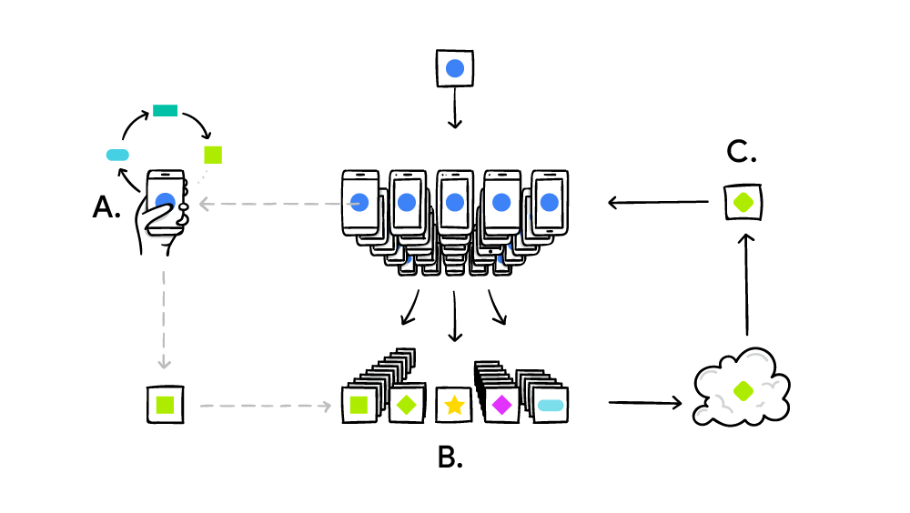
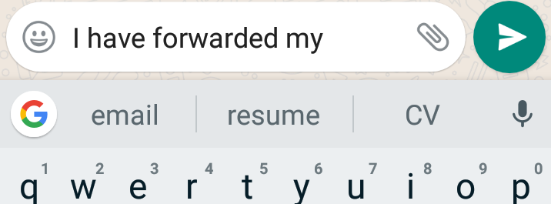
Federated Learning
Federated Learning is a decentralized approach for training models on user devices, personalizing the process and ensuring privacy by summarizing local changes and only sending to the cloud a focused update from the local model
FL trains language models on client devices without exporting sensitive user data to servers and has been successful at tasks like Next Word Prediction for mobile keyboards
https://ai.googleblog.com/2017/04/federated-learning-collaborative.html

Slide 3
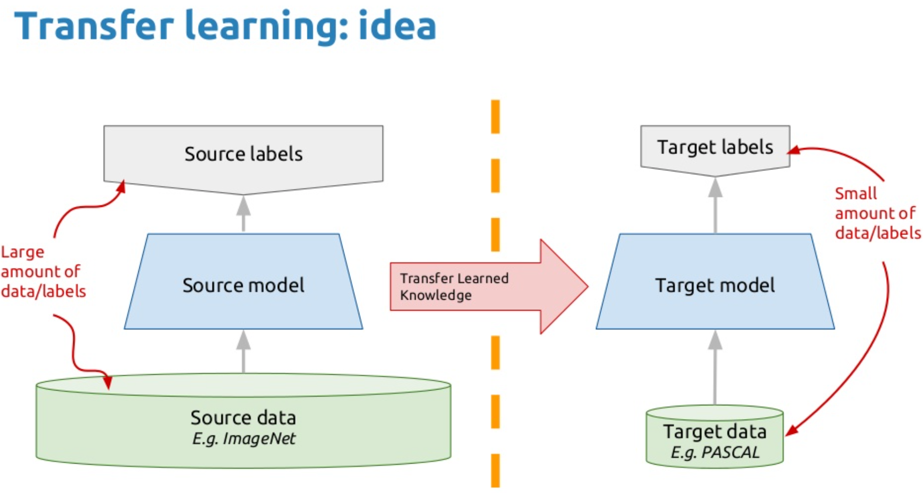
Transfer Learning
“Situation where what has been learned in one setting is exploited to improve generalization in another setting” - Goodfellow et al.
Models tasked to solve complex problems depend on copious data, but getting a ton of labelled data for supervised models can be difficult
“After supervised learning — Transfer Learning will be the next driver of ML commercial success” - Andrew Ng
https://medium.com/the-official-integrate-ai-blog/transfer-learning-explained-7d275c1e34e2

Slide 4
Related Work
Transfer Learning for Computer Vision:
VGG-16, VGG-19, ResNet-50 etc.
Transfer Learning for NLP:
BERT, XLNet, RoBERTa etc.
https://www.oreilly.com/content/not-hotdog-vs-mission-critical-ai-applications-for-the-enterprise/
https://www.theverge.com/tldr/2017/5/14/15639784/hbo-silicon-valley-not-hotdog-app-download
https://www.seroundtable.com/google-bert-update-28427.html

Slide 5
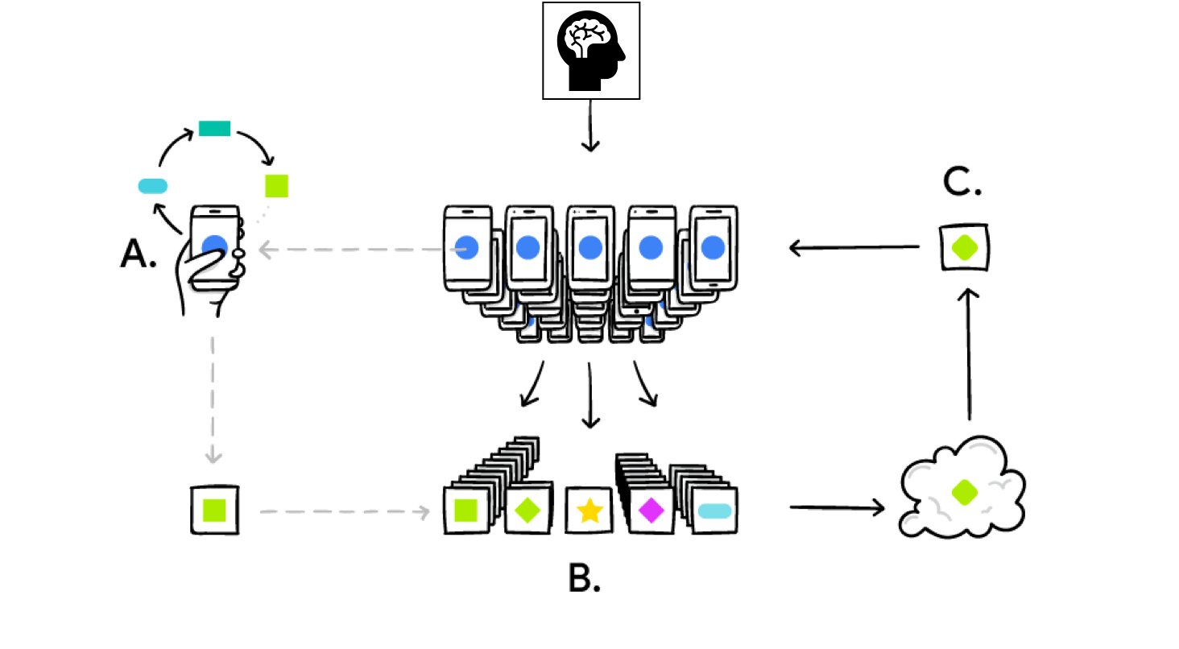
Problem Formulation: Pretrained Federated Models for Text
In this research we:
Combine the ideas of FL and Transfer Learning to produce pretrained federated models
Develop and enhance baseline text models using LSTMs for the task of Next Word Prediction in the federated setting
Introduce the idea of pretrained models and pretrained word embeddings to reduce required training rounds and increase the accuracy of federated text models
https://ai.googleblog.com/2017/04/federated-learning-collaborative.html

Slide 6
Methods
In this research we replicate a baseline network architecture for next word prediction using the Federated Averaging algorithm to train an LSTM on the Stack Overflow dataset. Our enhancements include:
Centrally pretraining text models followed by federated fine tuning
Incorporating pretrained word embeddings instead of randomly initialized embeddings and fine tuning these embeddings while training the full network in the federated setting
Combining centralized pretraining and pretrained word embeddings with federated fine tuning

Slide 7
Experiments & Results: Deep vs Wide
Train and Validation Accuracy by Epoch: Small Network Deep vs Wide
Ceteris Paribus, the model architecture was changed by replacing 1 LSTM layer having 256 units, with a 2-stacked LSTM layer with 128 units each
The wider single LSTM network outperforms the deeper 2-stacked LSTM layer
Difference in train time is negligible

Slide 8
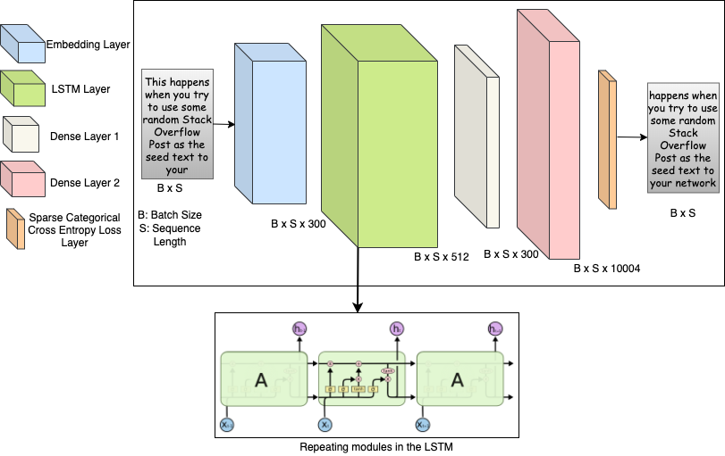
Model Architecture
Large Network Architecture
The output layer represents the top 10,000 most frequently occurring vocab words in the Stack Overflow dataset plus four special tokens: padding, beginning of a sentence, end of a sentence, and out of vocabulary
Accuracy is reported with and without these tokens
The model uses the Adam optimizer and Sparse Categorical Cross-entropy loss
We compare train and validation accuracy at each training round by sampling 10 non-IID client datasets per round, with a max of 5k text samples per client with 20 tokens each, and 20k val samples
https://colah.github.io/posts/2015-08-Understanding-LSTMs/

Slide 9
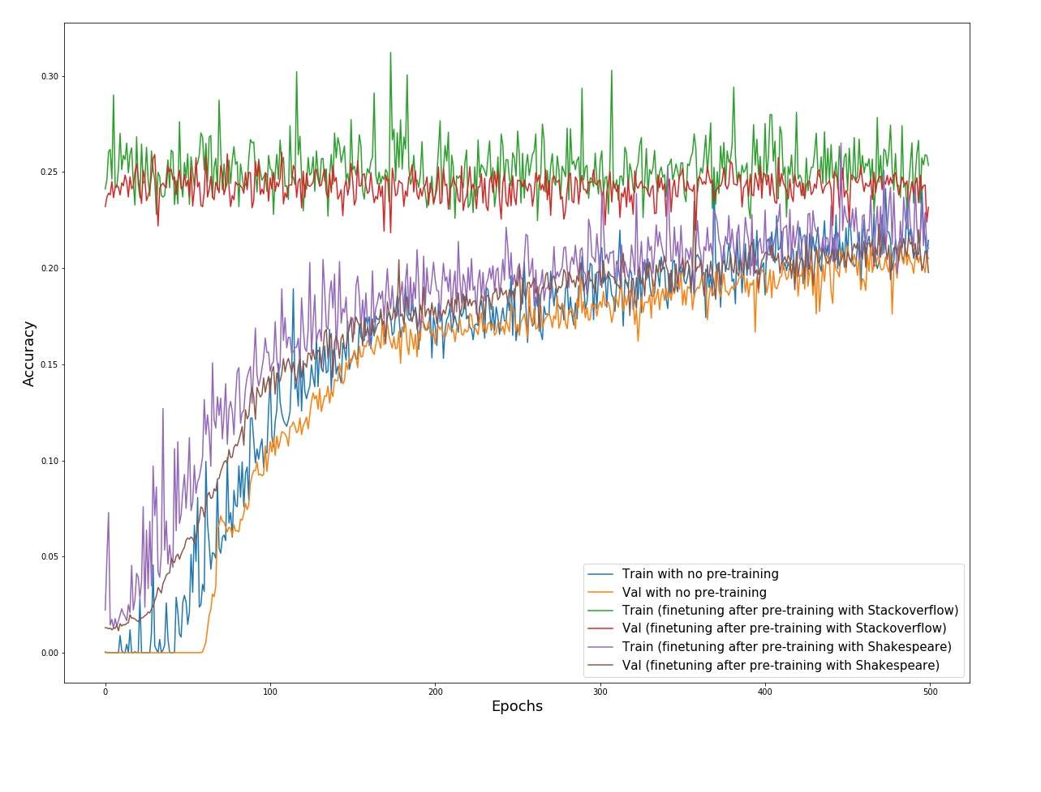
Experiments & Results: Pretrained Models
Train and Validation Accuracy by Epoch: Small Network Full Model Pretraining
Model centrally pretrained using (a) Shakespeare Data and (b) Stack Overflow data
Pretrained model, fine-tuned in federated style using Stack Overflow data (distinct samples)
Central pretraining outperforms no pretraining for both cases
Central pretraining using SO outperforms SP
Downstream fine-tuning adds value for SP based pretraining, but not for SO based fine-tuning

Slide 10
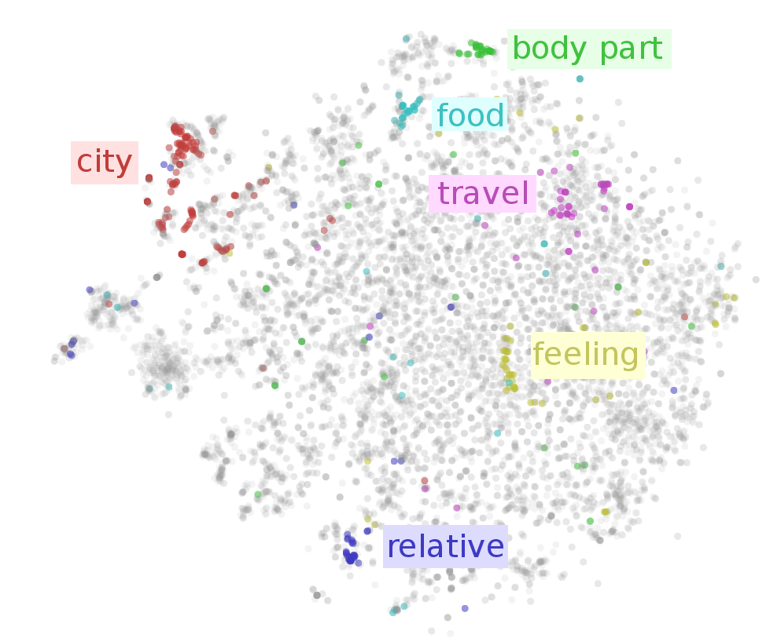
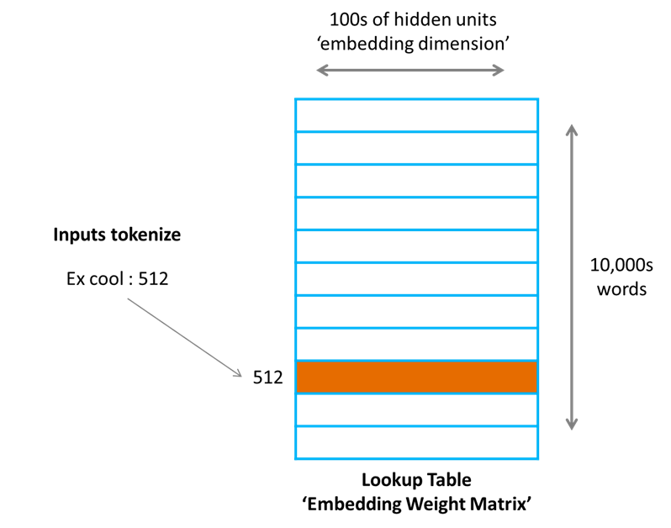
Word Embeddings
“You shall know a word by the company it keeps” - John Rupert Firth
Word2vec and Glove are to NLP what VGGNet is to vision: intelligent weight initialization
Large text DNNs are prohibitively large for federated training at present, but information from large networks can be captured in word embeddings
Input Tokens i.e. “cool”
https://towardsdatascience.com/what-the-heck-is-word-embedding-b30f67f01c81
https://ruder.io/word-embeddings-1/

Slide 11
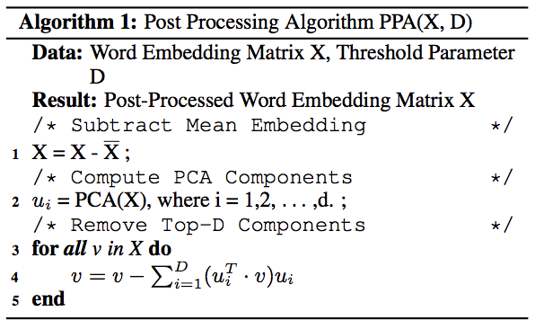
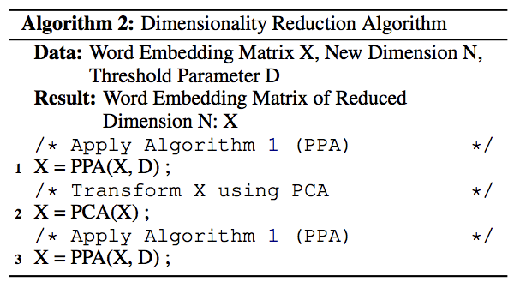
Word Embeddings: Dimensionality Reduction Algorithm with PCA and Post-Processing
What about really large embeddings?
Mu and Viswanath. “All-but-the-Top: Simple and Effective Postprocessing for Word Representations.”
Raunak et al. “Effective Dimensionality Reduction for Word Embeddings."
Notes:
"the post-processing algorithm in (Mu and Viswanath, 2018) tries to improve word embeddings by projecting the embeddings away from the most dominant directions and considerably improves their performance by making them more discriminative" - page 1 Raunak et al. "(Mu and Viswanath, 2018) presents a simple postprocessing algorithm that renders off-the-shelf word embeddings even stronger, as measured on a number of lexical-level and sentence-level tasks. The algorithm is based on the geometrical observations that the word embeddings (across all representations such as Glove, word2vec etc.) have a large mean vector and most of their energy, after subtracting the mean vector is located in a subspace of about 8 dimensions. Since, all embeddings share a common mean vector and all embeddings have the same dominating directions, both of which strongly influence the representations, eliminating them makes the embeddings stronger. " - page 2 Raunak et al. Post Processing Algorithm PPA(X, D): subtract the mean compute PCA components subtract from each vector in X the direction explained by principle component ui of D "This makes the individual word vectors more ‘discriminative’, hence, improving their quality, as validated on several benchmarks in (Mu and Viswanath, 2018)." - page 2 Raunak et al.

Slide 12
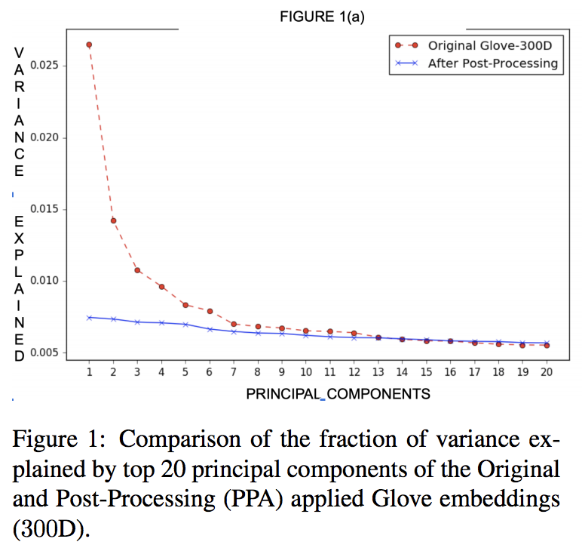
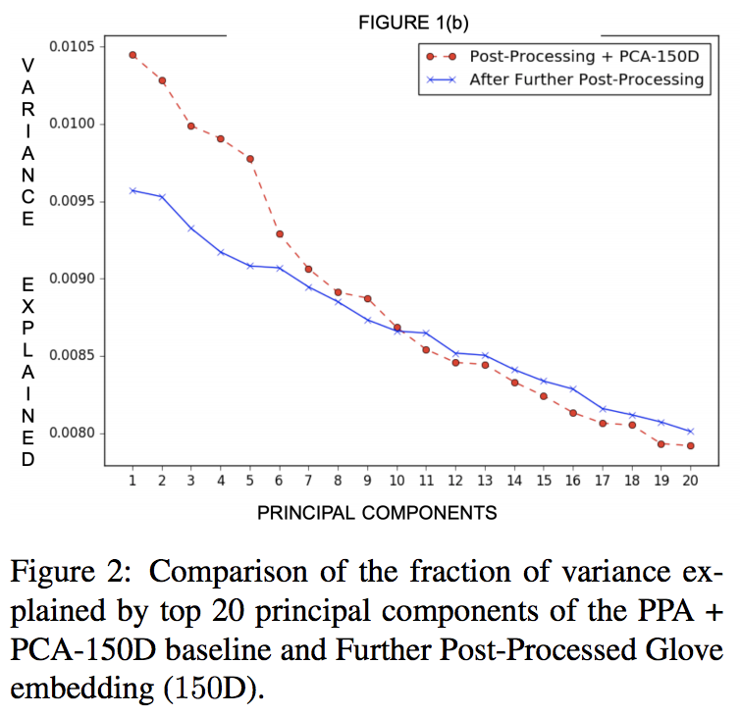
Word Embeddings: Variance Explained before and after Post- Processing with Algorithms 1 & 2
Variance explained by top 20 principal components for GloVe embeddings
Algorithm 1 (top): subtract the mean vector from all word vectors as well as the directions of variation explained by the top D principle components
Algorithm 2 (bottom): post-processing + PCA + post-processing
Raunak et al. demonstrate the effectiveness of Algorithm 2 on a variety of word similarity benchmarks, achieving performance equal to or better than embeddings of twice the size across a majority of similarity tasks
Mu and Viswanath. “All-but-the-Top: Simple and Effective Postprocessing for Word Representations.”
Raunak et al. “Effective Dimensionality Reduction for Word Embeddings."
Notes:
Further post processing makes word embeddings more discriminative by removing variation from the top components after applying PCA.

Slide 13
Word Embeddings: Pretrained Embeddings
GloVe from Pennington et al.:
Learn word vectors based on the probability of word co-occurrence across a text corpus
FastText from Bojanowski and Grave:
Learn word vectors by summing character level n-gram vectors based on character level n- gram context (predict target n-gram given context or vice versa)
GPT2 Radford and Wu:
Learn word vectors from the task of next word prediction with a large Transformer architecture

Slide 14
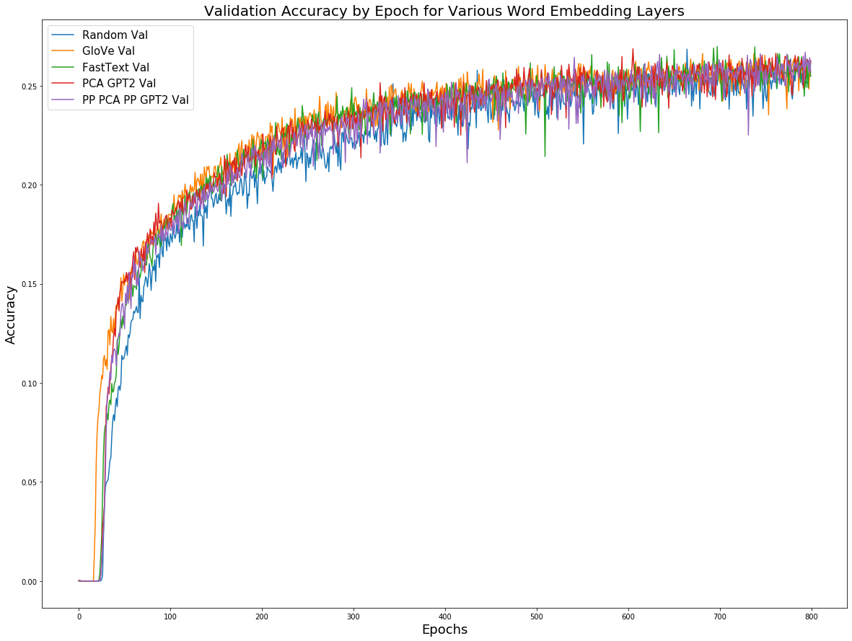
Experiments & Results: Pretrained Word Embeddings
Large Network Architecture
Pretrained embeddings achieve the same level of accuracy in fewer training rounds than random embeddings
Pretrained embeddings slightly outperform random embeddings in later training rounds, though random embeddings start to “catch up” on accuracy

Slide 15
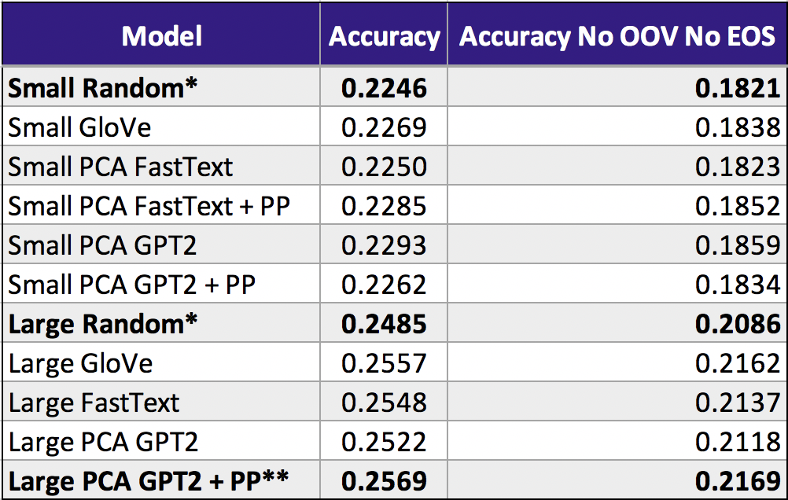
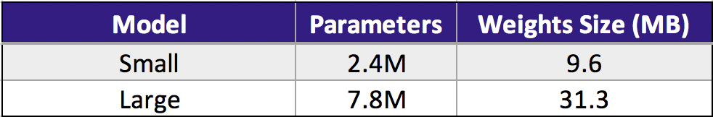
Experiments & Results: Pretrained Word Embeddings contd.
Pretrained embeddings outperform random embeddings for the larger network architecture by over a half percent on our test set of 1m text samples
Smaller networks demonstrate little to no increase compared to random embeddings
*Baseline
**Best
PP = PCA Dimensionality Reduction Post Processing Algorithm (PP + PCA + PP)

Slide 16
Experiments & Results: Pretrained Model + Pretrained Word Embeddings
Large Network Architecture
Our experiments demonstrate how to pretrain a model centrally and fine tune it in the federated setting, however…
Pretraining the large network on Shakespeare and fine tuning on Stack Overflow with the best word embedding method performed worse than federated training with random and pretrained embeddings
We suspect the following would yield better results for full model pretraining:
A dataset more similar to Stack Overflow
Learning rate optimization
Federated instead of central pretraining

Slide 17
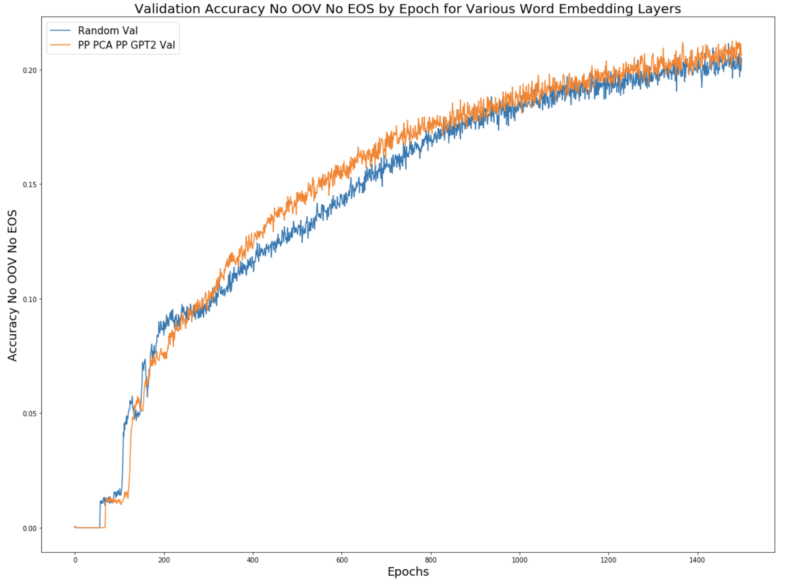
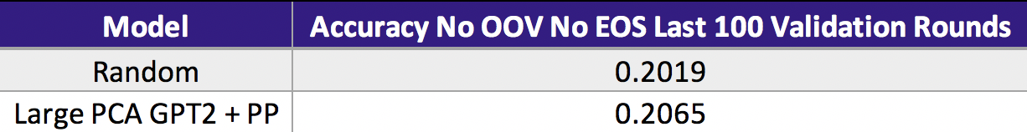
Experiments & Results: Pretrained Word Embeddings contd.
We compare our best embedding approach to randomly initialized word embeddings using the client sampling strategy and model architecture from ”Adaptive Federated Optimization”
We use the Adam defaults for optimization

Slide 18
Future Work
• Current research for NWP is limited to the Stack Overflow federated dataset, because the other federated text dataset, Shakespeare, currently only deals with character level tasks
• With more federated datasets available for NWP tasks, we can extend our pre-training and make it more robust
• Subsequently, we can also evaluate federated pretraining and federated fine-tuning, in addition to the current experiments using central pretraining and federated fine-tuning
• While small models seem to limit accuracy, further experimentation with small model architectures may yield improved results

Slide 19
Thank You!
Git Repo
Final Research Report

